Slide 1
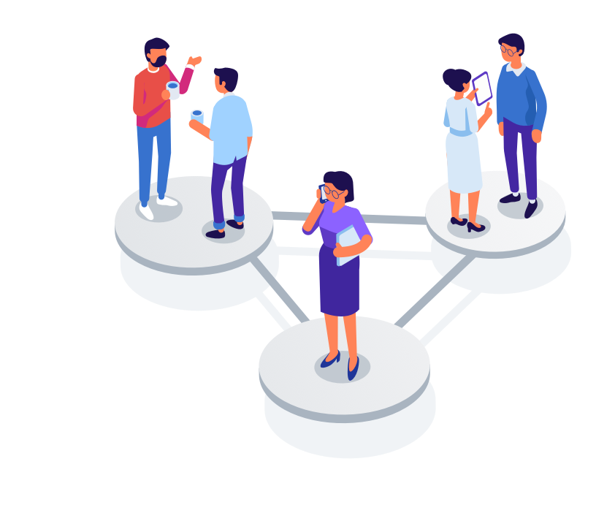
Customer Segmentation

Slide 2
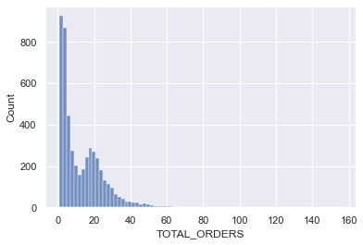
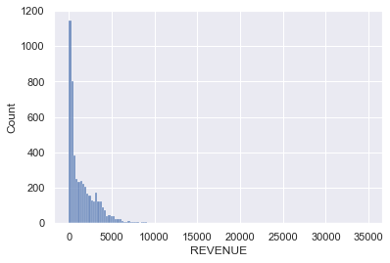
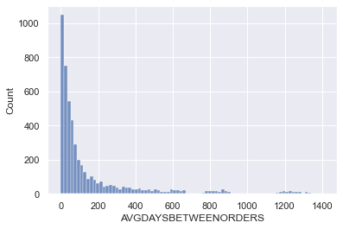
Project analysis slide 4
EDA Summary
The positive skewness of the three variables suggest customers need to be put into different segments based on these parameters and then make different strategies for different segments to maximise the sales.
.

Slide 3
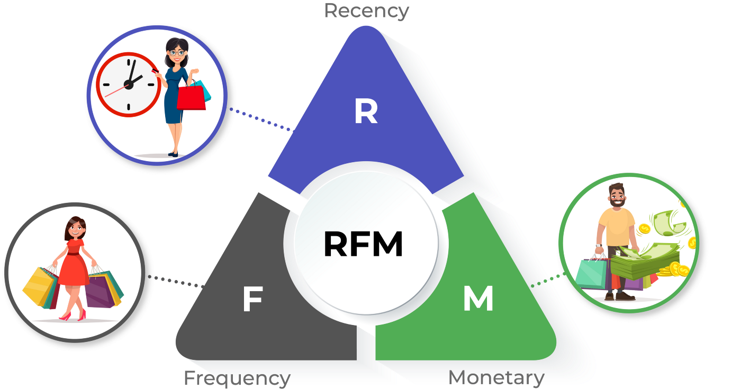
Project analysis slide 5
RFM Model
Recency
Frequency
Monetary
How much time has elapsed since a customer’s last activity or transaction with the brand?
How often has a customer transacted or interacted with the brand during a particular period of time?
This factor reflects how much a customer has spent with the brand during a particular period of time.

Slide 4
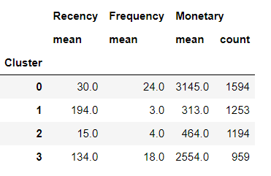
Project analysis slide 6
K-means
clustering
To do the customer segmentation using RFM model here, I have used K-means clustering, where the value of K is take 4 considering the problem. .
The objective of K-means is : group similar data points together and discover underlying patterns
After applying the K means clustering we get a table through which we can identify Potential customers, Champions, Need Attention. .
There are three conditions for applying K-means :
1. The data should not be skewed.
2. There should not be any outliers.
3. The data must have same mean and variance which we are doing by making mean 0 and variance 1.
.

Slide 5
Project analysis slide 8
Analysis
More Recency
Less Recency
More Frequency
More Frequency
Champions since they recently shopped, they shop often and they purchase high revenue items.
We need strategies to add more value to their shopping experience
Need Attention since theses customers shopped often and that too high value items but they have not made a purchase recently.
We need strategies to tackle the customer churn by first identifying the reason and then fixing it.
High Monetary
Less Frequency
Less Frequency
Potential Customers these customers made a purchase recently, have made a few orders and hence low monetary value.
We need strategies to keep them coming back to the business.
Lost customers are the ones who have not made a purchase recently and in the past they made few purchase with low monetary value.
We do not need to do anything about them.
Low Monetary

Slide 6
Project analysis slide 10
Conclusion
Champions are the best customers, since the mean monetary value is highest for them so giving discounts would not do any good instead focus on improving the shopping experience for them by giving them product recommendations or priority customer service etc.
For Potential customers we can offer them more discounts like $15 off on $75 so they keep coming back and an offer for subscription to the services could be another way.
Cluster 0 - Champions
Cluster 2 - Potential Customers
Cluster 3 - Need Attention
Need attention customers can be further classified based on the reason of their churning. If price sensitivity is the reason then a discount on their wish listed items or discount on the items based on their purchase can be a good choice .

Slide 7
Thank You

